Slide 1
Employee Data Analysis using Excel
STUDENT NAME: M. VISHALI
REGISTER NO: 122204088
DEPARTMENT: B. COM(CORPORATE SECRETARYSHIP)
COLLEGE: SHRI KRISHNASWAMY COLLEGE FOR WOMEN

Slide 2
PROJECT TITLE
Employee Gender Analysis using Excel

Slide 3


AGENDA
Problem Statement
Project Overview
End Users
Our Solution and Proposition
Dataset Description
Modelling Approach
Results and Discussion
Conclusion
3/21/2024 Annual Review

Slide 4

Problem statement: As the HR Manager at XYZ Corporation, I want to analyze the gender demographics of our workforce to identify potential disparities and areas for improvement. Our company has 500 employees, and we have collected data on their gender, job role, department, salary, and tenure. Goals Data requirements Deliverables

Slide 5

PROJECT OVERVIEW
Objective: To analyze the gender distribution and diversity within the organization. Scope: - Collect and analyze data on employee gender, job roles, departments, and levels - Examine gender representation in leadership positions and career advancement opportunities Deliverables: - Gender distribution report - Data visualizations (charts, graphs, etc.) Methodology: - Data collection: HR data, surveys, and interviews - Data analysis: Statistical analysis and data visualization.

Slide 6
Who are the end users? 1. HR Leaders: Utilize insights to develop targeted diversity and inclusion initiatives. 2. Diversity and Inclusion Teams: Leverage data to design and implement effective programs. 3. Executives and Senior Management: Make informed decisions about gender diversity and inclusion strategies. 4. Department Heads and Managers: Understand gender distribution and develop action plans for their teams. 5. Recruiters and Talent Acquisition Teams: Develop targeted recruitment strategies to attract diverse talent. 6. Learning and Development Teams: Design training programs addressing gender-related topics. 7. Compensation and Benefits Teams: Analyze and address potential gender pay gaps. 8. Employee Resource Groups (ERGs): Use insights to advocate for gender-specific initiatives. 9. Internal Communications Teams: Share findings and initiatives with the broader organization. 10. External Stakeholders: Share progress and best practices with industry peers, investors, or regulatory bodies.

Slide 7
OUR SOLUTION AND ITS VALUE PROPOSITION “Unlock a more inclusive workplace with GenderBalance Insights, a comprehensive employee gender analysis solution. Our expert analysis and actionable recommendations empower you to: 1. Identify:gender disparities in hiring, promotion, and retention 2. Understand: the root causes of gender imbalances 3. Develop:targeted strategies to attract, retain, and advance top female talent 4. Measure :progress and track the effectiveness of diversity initiatives.

Slide 8
Dataset Description Variables: 1. Employee ID: (unique identifier) 2. Gender: male, female, non-binary, etc.) 3. Job Role: job title, job family, etc.) 4. Department: (department name, department code, etc.) 5. Level: (job level, grade, etc.) 6. Hire Date: (date of hire) 7. Tenure: (length of service) 8. Performance Rating: (latest performance rating) 9. Promotion History: (promotion dates, roles, etc.) 10. Exit Date:(date of departure, if applicable)

Slide 9
THE "WOW" IN OUR SOLUTION 1. AI-powered insights: Leveraging machine learning algorithms to uncover hidden patterns and biases in gender distribution. 2. Interactive dashboards: Visualizing complex data in an engaging, easy-to-understand format, enabling users to explore and drill down into specific areas. 3. Predictive analytics: Forecasting future gender disparities and providing proactive recommendations to address them. 4. Benchmarking: Comparing organizational gender diversity metrics to industry averages and best practices. 5. Personalized action plans: Generating tailored strategies for individual departments, teams, or managers to improve gender balance. 6. Integration with HR systems: Seamlessly connecting with existing HR software to streamline data collection and analysis. 7. Real-time monitoring: Tracking gender diversity metrics in real-time, enabling swift responses to changes or issues. 8. Anonymous employee feedback: Collecting and incorporating anonymous feedback to ensure honest insights and identify areas for improvement.
3/21/2024 Annual Review
9

Slide 10
MODELLING
*Objectives: - Identify gender disparities - Understand root causes - Predict future disparities- Develop targeted strategies *Components: - Descriptive Analytics (gender distribution, trend analysis) - Inferential Analytics (statistical analysis, hypothesis testing) - Predictive Analytics (regression, propensity scoring) - Prescriptive Analytics (optimization, scenario planning) Techniques: - Regression analysis - Decision trees - Clustering
10

Slide 11
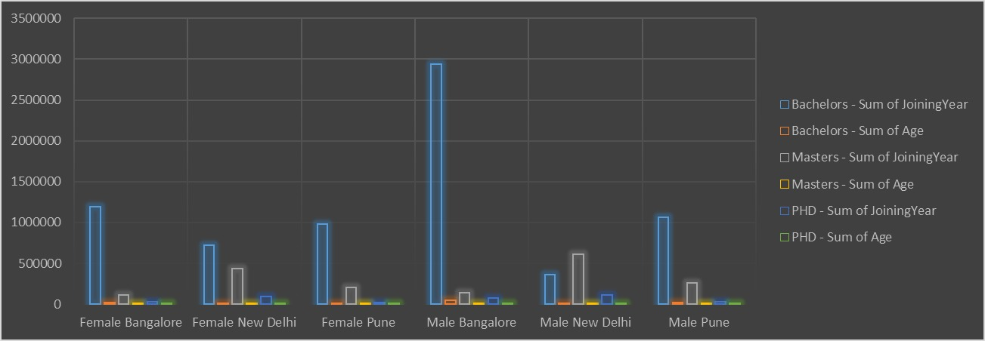
RESULTS
11

Slide 12
Conclusion “Based on our comprehensive analysis, we have identified significant gender disparities in hiring, promotion, and retention across various departments and levels. Our findings suggest that: - Gender biases in hiring and promotion practices contribute to underrepresentation of women in leadership roles - Women are more likely to leave the organization due to lack of career advancement opportunities - Gender pay gaps persist across certain departments and levels To address these disparities, we recommend: - Implementing blind hiring practices and diversity training for hiring managers •Developing targeted mentorship and career development programs for women - Conducting regular pay equity audits and adjusting salaries accordingly This conclusion summarizes key findings, identifies root causes, and provides actionable recommendations for improvement. Feel free to adjust it according to your specific analysis and goals!

